Slide 1

Community Fake News Eliminator
Team Name : Cloudemic
Praveen N
Kaleelurrahaman U

Slide 2

Problem statement
In the current world the spreading of fake news has cased fear and havoc among people. This is widely seen during the pandemic (COVID 19).
The Fake news that includes symptoms, treatments and political agenda towards the situation is raising by day by day.
The fake news scales faster and before we know it’s a fake, we receive the second wave of the same message.
There is no current solution that stops the flow of these messages.

Slide 3


Slide 4
Solution Approach
The proposed solution uses the IBM Visual recognition service to provide a real time update of the message that is received is fake or not.
The solution is to create a web service which returns the image/text is FAKE/FACT by using the IBM cloud services.
The FAKE images are placed in the IBM cloud database and the images that we receive as the input for the created service is matched across the DB.
When the source image/text match with the images/text in the DB then the source image is watermarked as FAKE and returned to the user application.
The web services can be used across multiple application in the future to eliminate the spread of fake news.

Slide 5
Solution Approach
Additional to the web service, we can provide the user the control to inform the message received by them is FAKE or FACT.
The image will be added to the FAKE Database queue and the information that some user has said the message is FAKE/FACT will be available to all users.
From the FAKE Database queue the image will be screened and moved to the actual Database/Folder after fact check.
This functionality gives the power for any user to inform the credibility of the news.

Slide 6
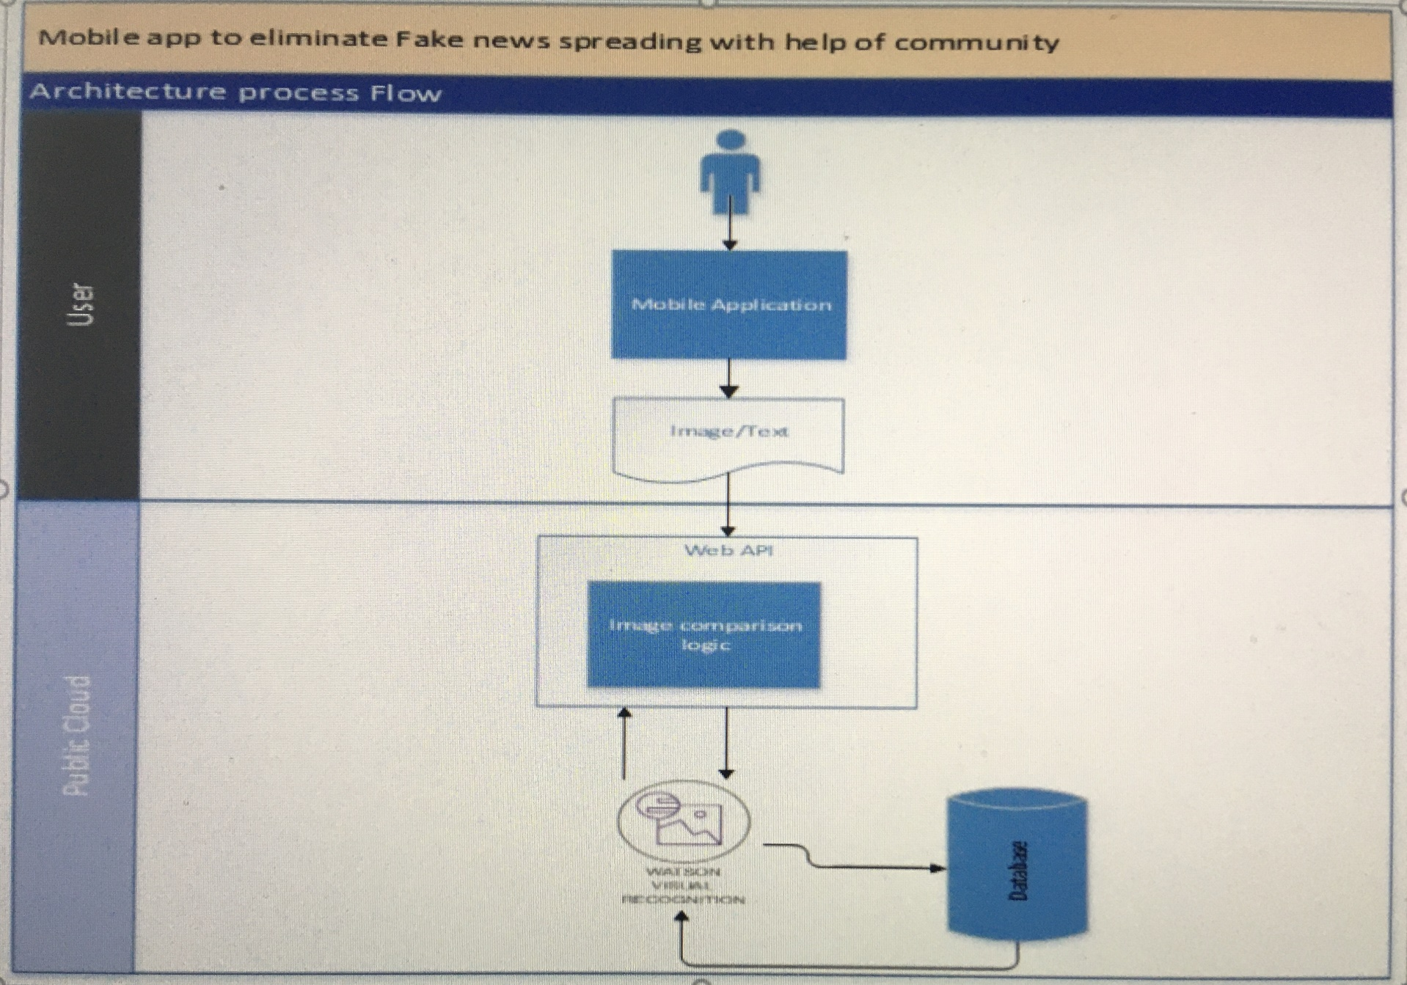
Architecture

Slide 7
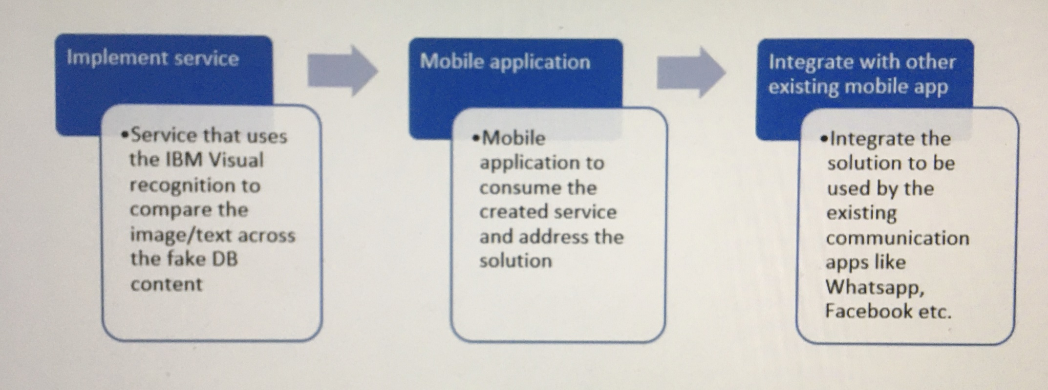
Road Map

Slide 8
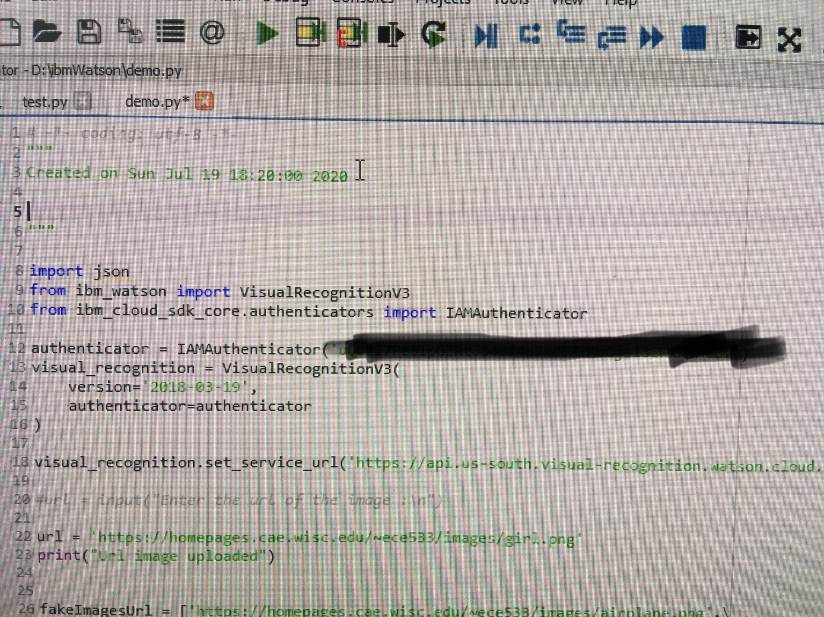
Source Code

Slide 9
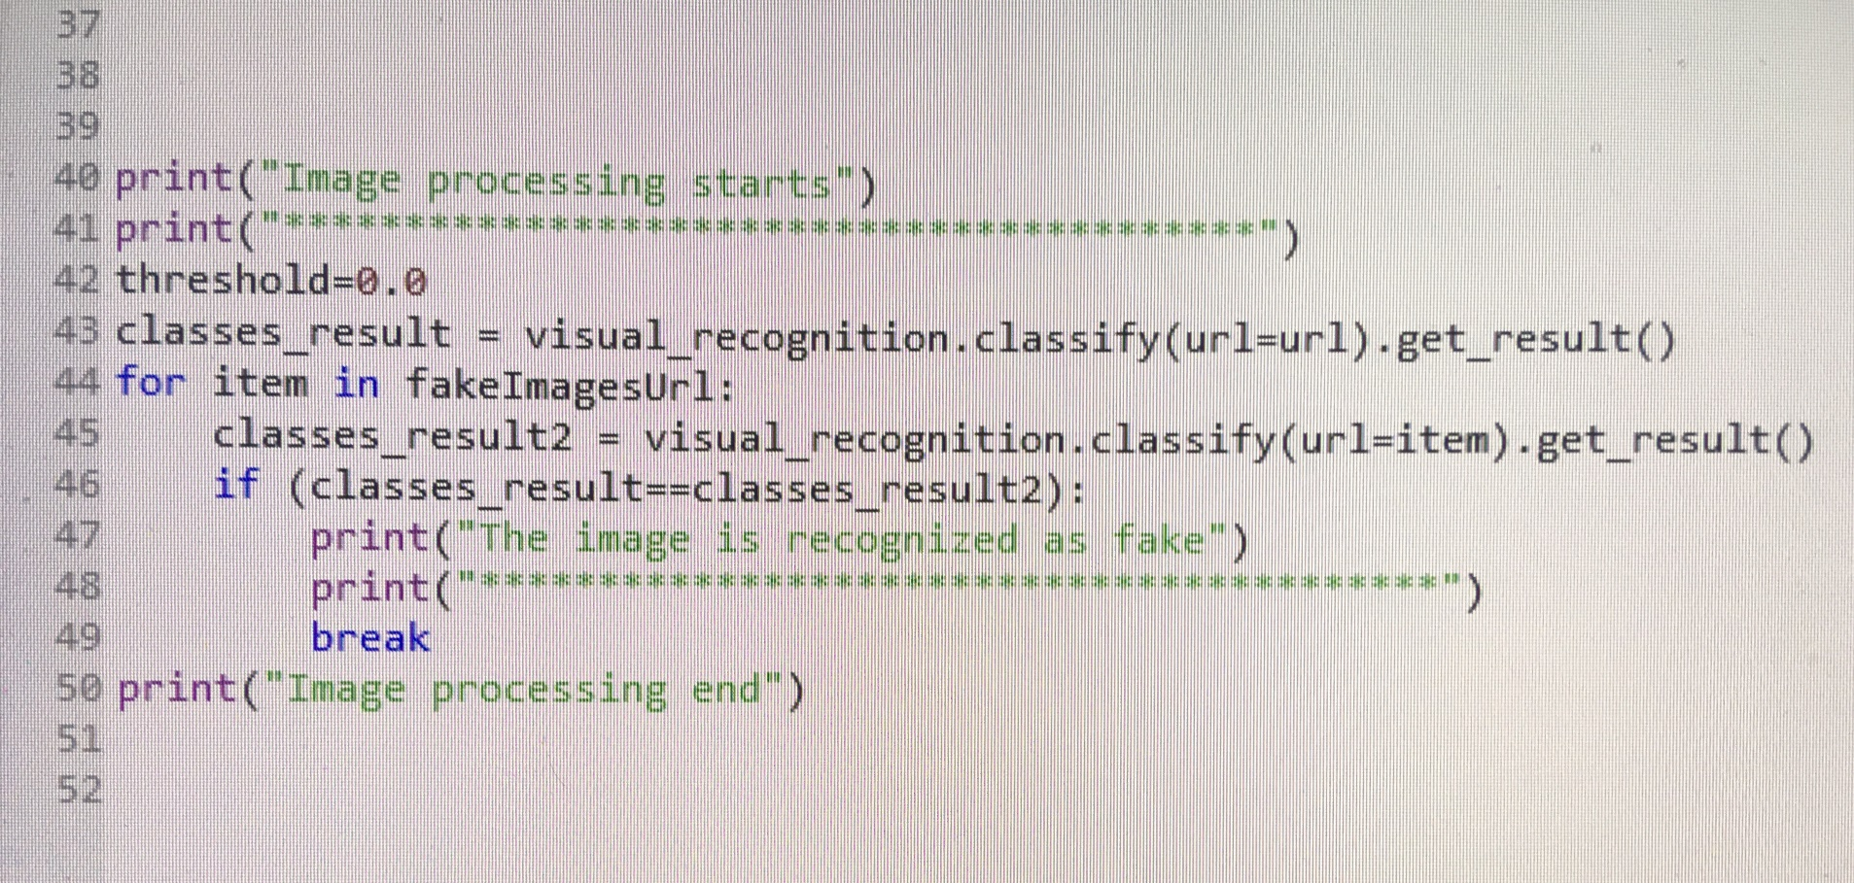
Source Code

Slide 10
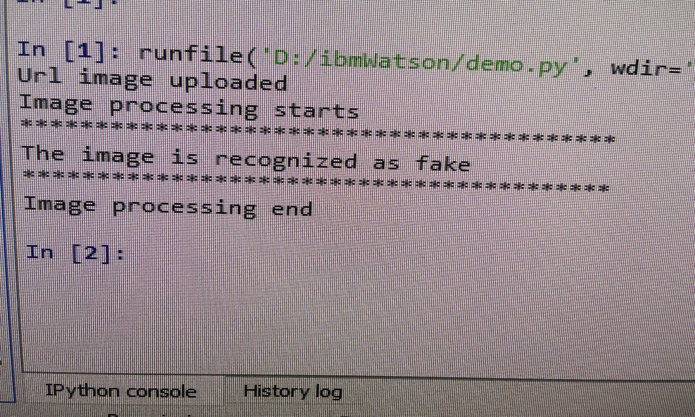
Output

Slide 11
Thank You

